Slide 1
JAVA PROJECT BATCH
GUI Programming
Lecture 1

Slide 2
Table Of Contents
01.
Types Of Applications Developed In Core Java
02.
Introduction To GUI
03.
Packages available
To
develop GUI applications
04.
Developing AWT Based Application in Java

Slide 3


Types of Applications In Core Java
• In Java SE, we can develop 2 types of applications:
CUI – Command User Interface based apps
GUI – Graphical User Interface based apps
CUI applications are those which we have been developing till now . Such
applications are good for understanding the basics of a language but are not used in
real world scenario.
GUI applications are developed and used in real world. They are user friendly and
hence possibility of errors is also minimized.

Slide 4
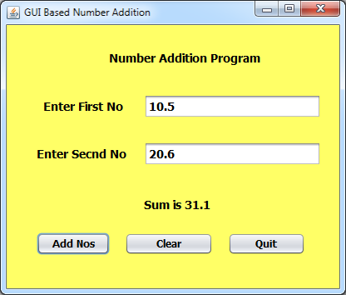
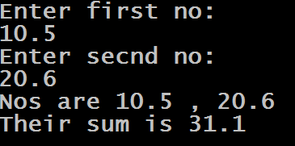
Types of Applications
CUI – Command User Interface
GUI – Graphical User Interface.

Slide 5
Categories Of GUI Based Apps
• There are possibly 2 types of GUI based applications which can be developed using Java SE
Applets :- Applets are small applications which are developed and compiled in
the same way like a normal java program is developed. But they are executed
using a Web Browser. The web browser has a built in JVM which is called as AppletEngine
2. Applications :- Java programs which display output on windows desktop rather than command prompt. They have various graphical elements to receive input from the user.

Slide 6
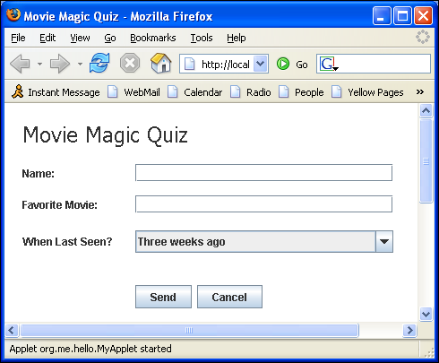
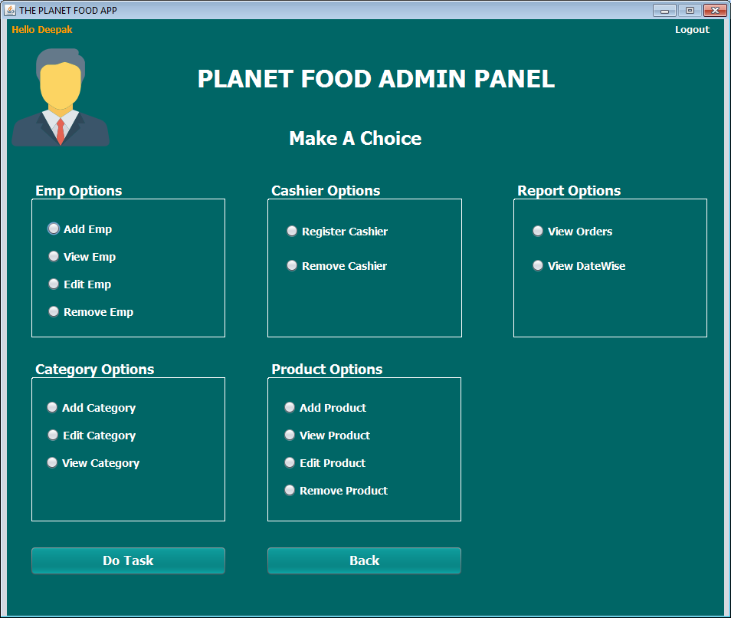
Categories Of GUI Based Apps
An Applet
An Application.

Slide 7
Packages available to develop GUI application
• There are two packages available to develop GUI based applications
java.awt :-
The term awt stands for Abstract Window Toolkit
Java introduced GUI applications through java.awt package, which contains all graphical
components as classes.
But in a hurry to compete Java lost its motto of platform independence because awt uses
graphical components from the underlying Operating system which is against java’s
platform independence.
Hence, an application might look different on different platforms.

Slide 8
Packages available to develop GUI application
2. javax.swing :-
Every graphical component is present in form of classes and every component is
programmed using Java.
This helps us retain Java’s platform independence policy.
The look and feel of application will be same across every platform.
Package name is javax.swing and the letter “x” stands for extended.

Slide 9
An Important Point !
Although swing technology for GUI is far better than awt as it has much better scale of graphical components and is also platform independent.
But to understand some key concepts of GUI programming we will initially use awt
and then switch to swing.

Slide 10
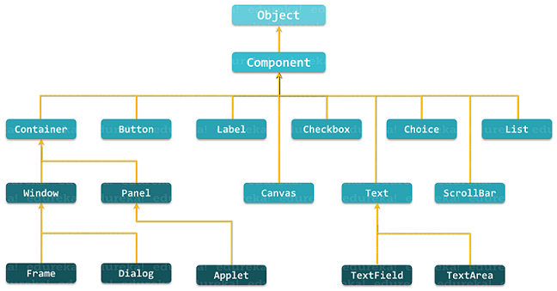
The awt Class Hierarchy

Slide 11
Introducing The Frame Class
• The Frame is a special type of Window which is the top level window with border
and title
• It’s the first window we design in a Java based GUI app and it acts as a
container for holding other components like Buttons , Labels , ListBoxes etc
• To create a Frame we use the class java.awt.Frame

Slide 12
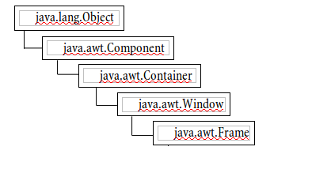
The Frame Hierarchy

Slide 13
Methods Of The Frame Class
• Constructors Of Frame class
1. public Frame( )
2. public Frame(String)
Methods Of Frame class
1. public void setTitle(String)
2. public String getTitle( )
3. public void setSize(int width,int height)
4. public void setLocation(int x,int y)
5. public void setBounds(int x,int y,int w,int h)
6. public void setVisible(boolean v)
7. public void setBackground(Color obj)
8. public void add(Component c)
9. public void setLayout(Layout obj)

Slide 14
Developing Frame Based Apps
• We can create a GUI using Frame in two ways:
By creating the instance of Frame class ( Association )
By extending the Frame class (Inheritance)

Slide 15
Creating And Using Frame Instance
• Steps required :-
Import the required packages and classes
Create the Main-Class
Within the Main-Class instantiate the Frame class
Call methods for setting size and if needed then location too.
Set the visibility to true.

Slide 16
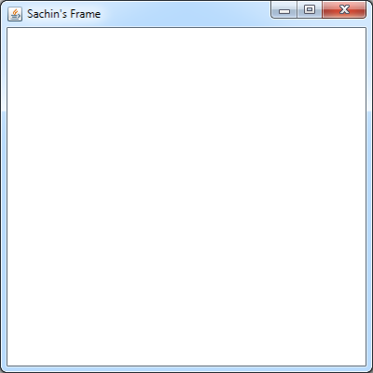
First Program Of Frame
package sca.gui.awt.examples;
import java.awt.Frame;
public class Example1 {
public static void main(String[] args) {
Frame fr=new Frame();
fr.setTitle("Sachin's Frame");
fr.setSize(400, 400);
fr.setLocation(200, 200);
fr.setVisible(true);
}
}

Slide 17
Changing The Background Color
To change the background and foreground color of any GUI
Component , java provides us 2 methods called setBackground( ) and
setForeground( ) , both belonging to the class Component.
Following are their prototypes:
1. public void setBackground(Color)
2. public void setForeground(Color)

Slide 18
Changing The Background Color
The argument passed to these methods is an object of the class Color available in the package java.awt
To create a Color object we have to call the following constructor of the Color class
public Color(int red,int green,int blue)

Slide 19
Changing The Background Color
The arguments passed to the constructor represents the intensities of
"red", "green" and "blue" components of a color.
These values can range between 0 to 255.
For example to create a color object which represents "Red" color our
code will be:
Color c=new Color(255,0,0);

Slide 20
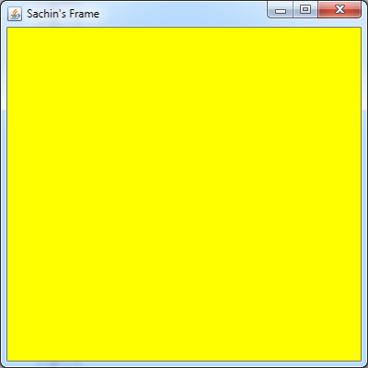
Second Example
package sca.gui.awt.examples;
import java.awt.Color;
import java.awt.Frame;
public class Example2 {
public static void main(String[] args) {
Frame fr=new Frame();
fr.setTitle("Sachin's Frame");
fr.setSize(400, 400);
fr.setLocation(200, 200);
fr.setVisible(true);
Color c=new Color(255,255,0);
fr.setBackground(c);
}
}

Slide 21
Java’s Predefined Color Objects
Java itself has provided us 13 predefined color objects which are declared as static members of
the Color class.
Their names are:
1. Color.red
2. Color.green
3. Color.blue
4. Color.white
5. Color.black
6. Color.magenta
7. Color.cyan
8. Color.yellow
9. Color.pink
10. Color.gray
11. Color.lightGray
12. Color.darkGray
13. Color.orange

Slide 22
Extending The Frame Class
The second and much recommended approach is to inherit the Frame class in our child class and provide all the infrastructure code in our child class constructor.
Infrastructure code means setting size , color, title ,
adding components etc

Slide 23
Creating Frame Using Inheritance
• Steps required :-
Import the required packages and classes
Create a child class which inherits the Frame class
Define a constructor in the child class
Write the infrastructure code in the constructor by calling appropriate methods of the parent class .
Create the Main-Class
6. Within the Main-Class instantiate the Child Frame class

Slide 24
Example
package sca.gui.awt.examples;
import java.awt.Color;
import java.awt.Frame;
class MyFrame extends Frame
{
public MyFrame()
{
setTitle("Sachin's Frame");
setSize(400,400);
setLocation(200,200);
setVisible(true);
setBackground(Color.yellow);
}
}
public class UseMyFrame{
public static void main(String[] args) {
MyFrame fr=new MyFrame();
}
}

Slide 25
Output

Slide 26


